Slide 1
Digital Communications
Notes:
1

Slide 2
Baseband data communications
1 +V (+1) held for T seconds S₁ (t)
0 -V (-1) held for T seconds S₂ (t)
Usually this signal is used to modulate the carrier (eg BPSK).
Upon reception, the signal is corrupted by noise. Noise is modelled as AWGN
Finite probability that an error will be made in determining which data value was transmitted

Slide 3
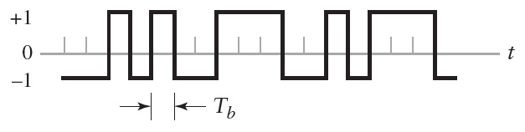
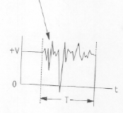
Baseband data communications
Rectangular pulse/ No bandwidth limitations
Polar non return to zero signalling

Slide 4
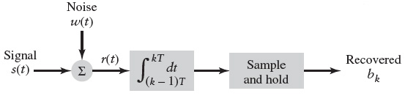
Integrate and Dump filter
Passing the signal through an integrator improves SNR

Slide 5
Integrate and Dump filter

Slide 6
Integrate and Dump filter

Slide 7
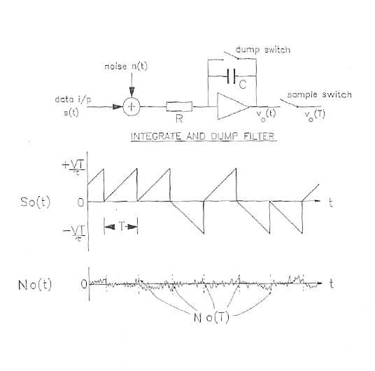
Integrate and Dump filter
SNR increases with increasing symbol duration (T) and increasing level (V). It is proportional to the symbol energy V²T.
Sampled signal voltage s(T) increases linearly with T.
Sampled Noise voltage increases as
Signal processing advantage of filter is

Slide 12
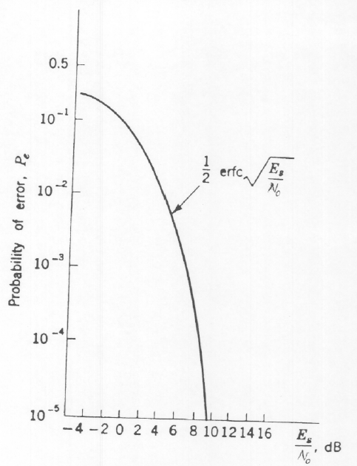
Probability of error, Pe
Pe rapidly decreases as Es /No increases
Maximum value of Pe= 0.5. (Thus, even if the signal is entirely lost in the noise, so that any determination by the receiver is a sheer guess, the receiver cannot be wrong more than half the time on average)
The average probability of symbol depends solely on Es/No

Slide 13
Optimum & Matched Filter Detection
Optimum is the filter that maximises SNR. Hence the ideal filter that minimises the effect of noise.
Is the Integrate & Dump Filter the Optimum Filter for the detection of a data signal in Noise?
For unfiltered rectangular data pulses in white noise the integrate & dump filter is the optimum or matched detector
In the case of filtered data transmission, the detection filter must be matched to the pulse shaping employed. If s(t) is the signal then:

Slide 14
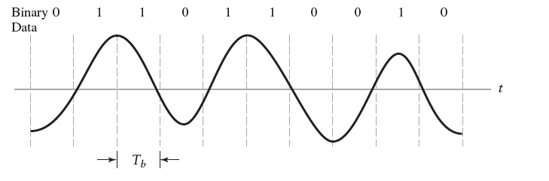
Optimum & Matched Filter Detection
In that case again SNR = 2Es/No and the BER is as before.
The term correlation receiver is often used in the case of coherent reception

Slide 15
Matched Filter Detection
noise
Independent of the waveform
Same result as the integrate and dump filter for square pulses

Slide 16
COHERENT RECEPTION: CORRELATION

